Slide 1


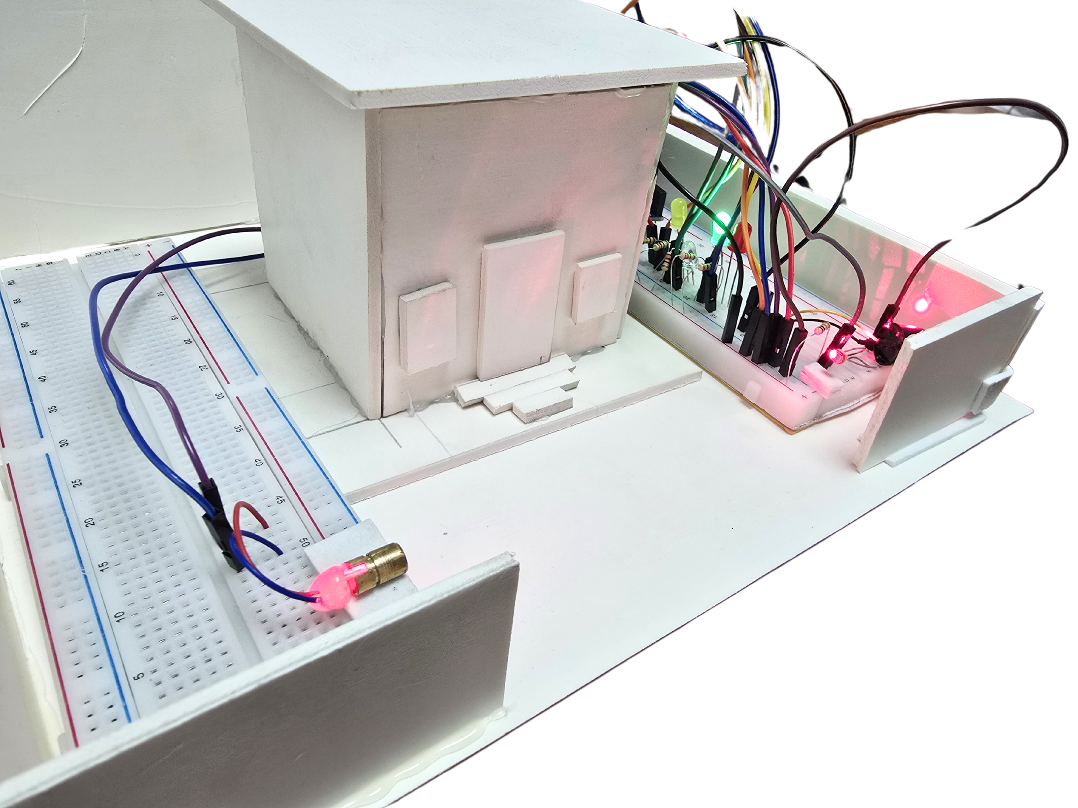


AMERICAN INTERNATIONAL UNIVERSITY-BANGLADESH
FACULTY OF ENGINEERING (EEE)
ELECTRONIC DEVICE LAB
GROUP PROJECT
GROUP-7
PROJECT TITLE:
“LASER ALARM SECURITY SYSTEM”
Notes:
hope you guys r well. we r frm grp 7, we made an amazing project to show u guys. the projct is laser alarm security system,

Slide 2







Our Team
RUPAM DEBNATH RODRA
MD TANVIR RAHMAN
BISHAL SAHA
SUDIPTO SAHA
MD. ISTIAQ MOZUMDER
TAHMID YOUSUF PRINCE
TAHMID YOUSUF
PRINCE
Rupam Debnath Rodra
MD. ISTIAQ MOZUMDER
TAHMID YOUSUF PRINCE
MD TANVIR RAHMAN
BISHAL SAHA
SUDIPTO SAHA
MD TANVIR RAHMAN

Slide 3

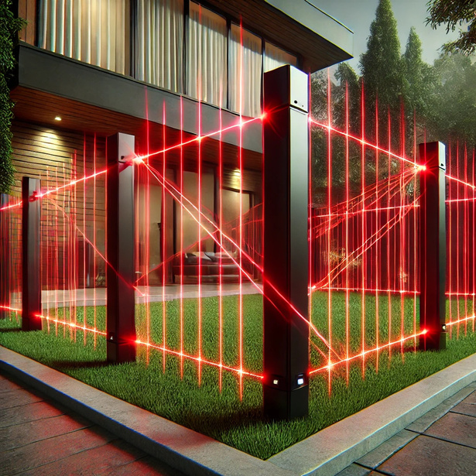
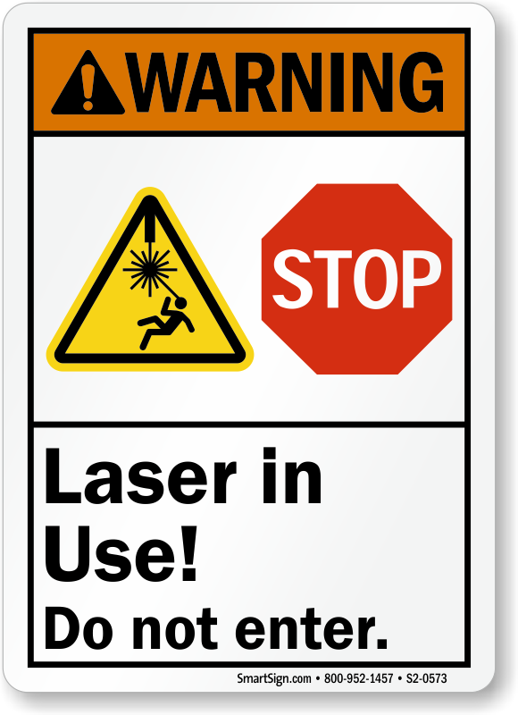
Introduction
About
Our
Project
The Laser Security System enhances security in homes, museums, and offices. It uses a laser beam and a
Light Dependent Resistor (LDR) to detect interruptions. When triggered, it activates a buzzer and LED indicators.
Built with an Arduino UNO, this project is easy to set up, cost-effective, and customizable.
Notes:
oour project basically used for secuirity purpous in home or private property. A laser beam is used in the system , if the laser is crossed by any thing then alarm get triggered and 2 LED start to beeping . Then if i want to sstop the alarm simply pressing the switch i can turn off the alarm. we also add a user system . for example if tyhe home owner want to disarmed the the security system simpy pressing the button then Green light will on and system will be turn off.

Slide 4

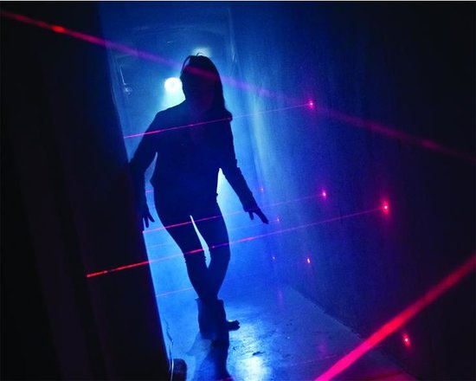
OBJECTIVE
DESIGN
Design and develop an efficient and accurate Laser Security System that can triggered an alarm after detecting any interpretation or crossing any object through the Laser.
OBJECTIVE
ENSURE
Ensure prompt alarm activation and response, providing adequate warning to occupants and enabling them to take timely safety precautions .
FOCUS ON
Focus on user-friendliness, ease of installation, and maintenance allowing the laser security system to be use in homes,fences, and private places.

Slide 5

MOTIVATIONS
Safety and Security: Develop a user-friendly LASER SECURITY ALARM SYSTEM to safeguard individuals and properties by preventing unauthorized access.
Innovation and Technology: Showcase how technology can enhance everyday safety and demonstrate its life-saving potential.
Skill Development: Foster problem-solving, communication, and project management skills, benefiting future careers and personal growth.
Notes:
Good [morning/afternoon], everyone.
Today, we are excited to present our Laser Security Alarm System, which was designed with the primary motivation of enhancing safety and security for individuals and their property. The main goal of this project is to develop an effective, user-friendly alarm system that can help prevent unauthorized access or intruders from crossing boundaries on private properties.
Incorporating innovation and technology into everyday life is key to progress. Through this project, we’ve showcased how such technology can be harnessed to create devices that not only improve security but can also save lives and make our environments safer. This is a perfect example of how technology can address real-world challenges.
Moreover, this project has provided an invaluable opportunity for skill development. As a team, we’ve worked on problem-solving, communication, and project management, which will be beneficial for our personal and professional growth.

Slide 6
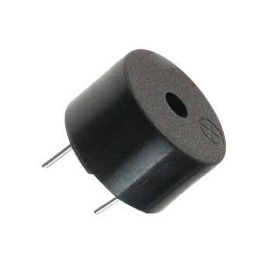
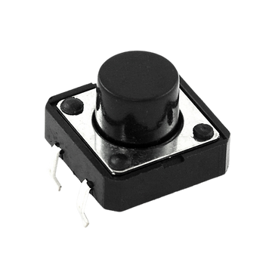

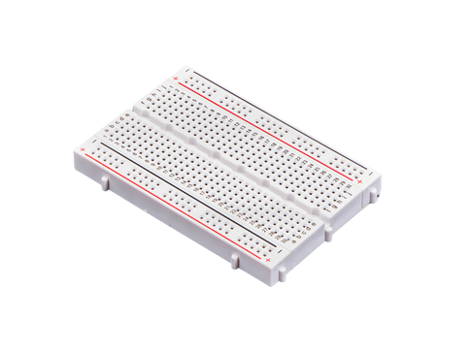
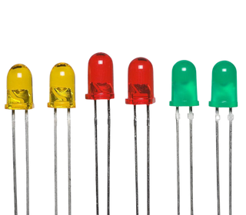
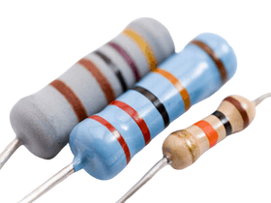
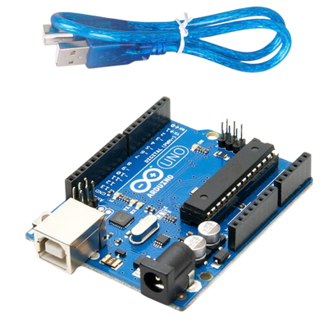
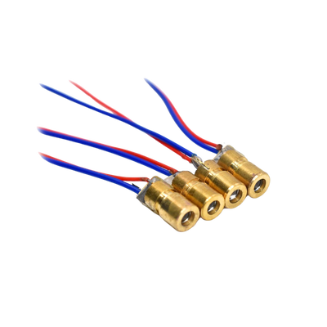

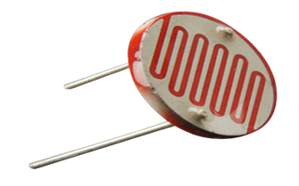
COMPONENTS
Buzzer
Arduino
Bread-Board
Resistors
4 x 220ohm,
2 x 10k ohm
Push-Button
LED’s
Some wires
Laser
Laser dependent resistor
Notes:
As for the components we used in the system, we integrated a buzzer, Arduino, breadboard, resistors, LEDs, wires, and a laser-dependent resistor, among others, to bring the system to life.
Thank you for your attention, and we hope you enjoy exploring the details of our Laser Security Alarm System.

Slide 7
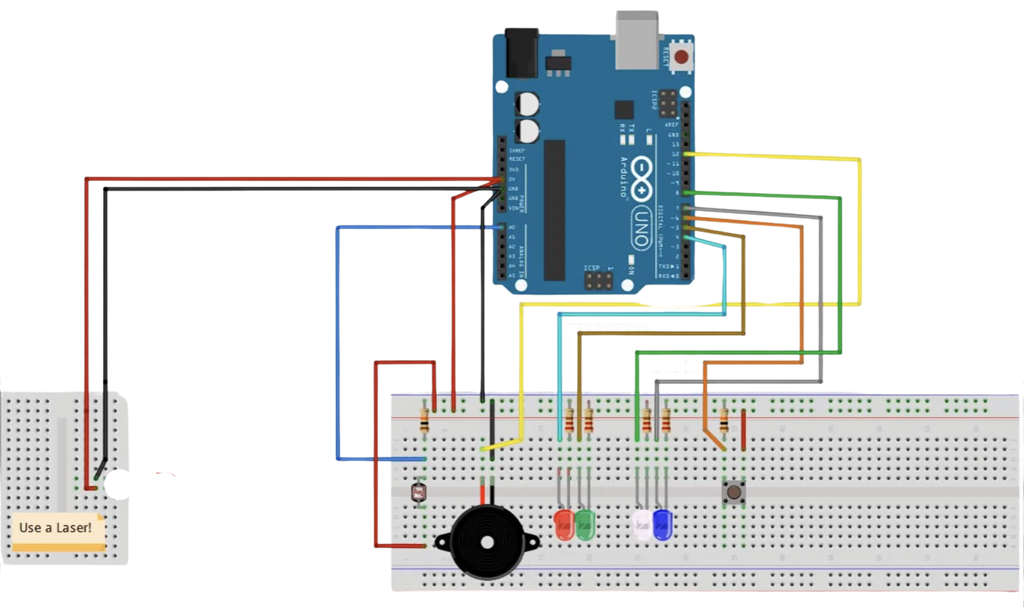
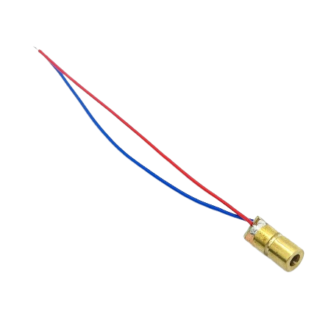
CIRCUIT DIAGRAM
Arduino
10k OHM
Laser
5 Volt Laser
Laser dependent resistor
Buzzer
Push-Button
LED
220 OHM

Slide 8
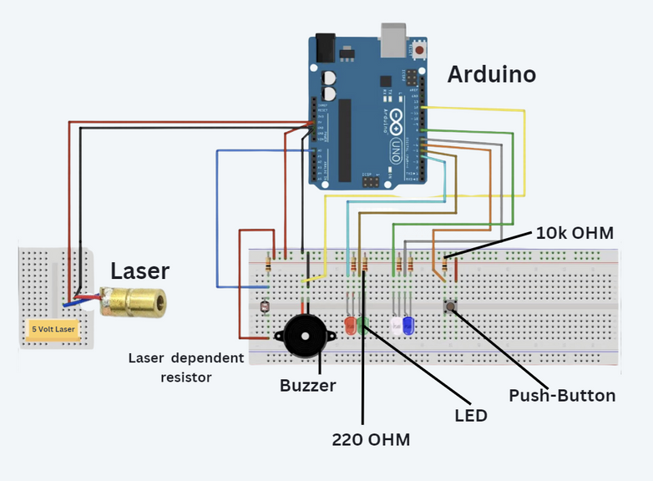
CIRCUIT DESIGN EXPLANATION
The laser security system circuit detects interruptions in a laser beam and triggers an alarm.
The key components include a laser module, LDR, Arduino UNO, buzzer, LEDs, and a reset button. The laser module emits a beam toward the LDR, which detects the beam and sends signals to the Arduino. In normal operation, the green LED remains ON, indicating everything is fine. When the laser beam is interrupted, the LDR detects the change, and the Arduino activates the buzzer and the red LED to signal an alert. To reset the system, the button is pressed, stopping the buzzer and resetting the LEDs. This circuit provides a simple yet effective way to create a laser-based security system.

Slide 9
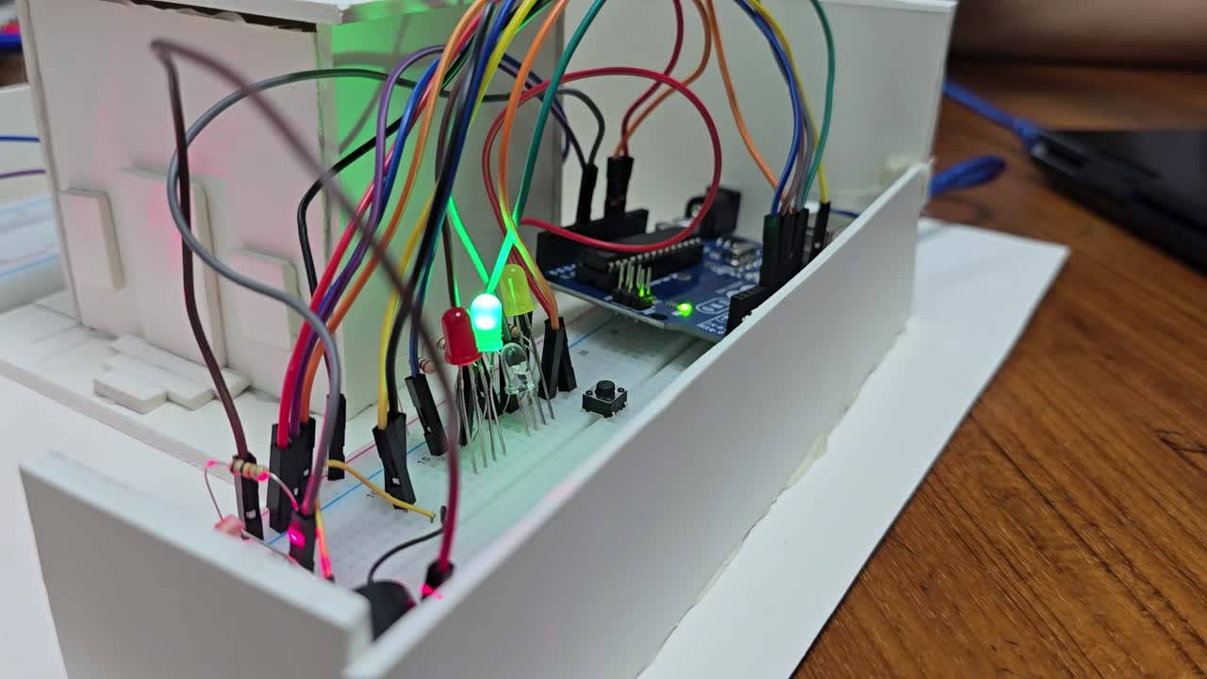

COMPONENTS
IMPLEMENTATION
we Implement all the components as shown in the circuit diagram in brad boar.
we Connect ARDUINO as the circuit.
we Connect the ARDUINO with Laptop/PC/MAC
then weUpload the codes.

Slide 10

ARDUINO SETUP
This Arduino code creates a security system that detects laser beam interruptions and triggers an alarm. The system is controlled by a switch:
When the switch is pressed, the system toggles between armed and disarmed states.
In the disarmed state, the green LED lights up, and laser interruptions do not trigger the alarm.
In the armed state, the red LED lights up, and crossing the laser beam triggers the alarm and flashing LEDs.

Slide 11
TESTING AND
CALIBRATION
Test 1: System Armed and Disarmed
The system is armed by pressing the Arm Button, turning on the RED LED and playing a tone. Pressing the button again disarms the system, turning on the GREEN LED and playing the tone again.
Test 2: Triggering the Alarm
If the laser beam is blocked or the sensor is moved while armed, the alarm triggers. The Triggered LEDs (WHITE & ORANGE) flash, and a rising and falling tone plays.
Test 3: Handling Alarm and Stopping It
The alarm activates when the sensor’s reading drops below the threshold. To stop the alarm, press the Arm Button. The buzzer and flashing LEDs will stop, and the system will return to its normal state.

Slide 12
RESULT
1.The laser Alarm Security System functions as expected.
2.System is armimg and disarming by pressing the push button.
3.Buzzer working perfectly.
4.laser interruption and alarm and LED beeping is functions perfectly.
Stoping the alarm sound and back to automatic armed mode functioned properly.
The system successfully responds to interruptions and operates as intended.

Slide 13
APPLICATIONS & ADVANTAGES
Advantages:
High Sensitivity
Easy to Set Up
Non-Intrusive Detection
Visual and Audible Alerts
Low Power Consumption
Cost-Effective
Applications:
Home Security
Industrial Applications
Museum/Art Gallery Security
Automated Detection Systems
Bank Vault Protection
CONCLUTION
CONCLUTION
CONCLUTION
CONCLUTION
CONCLUTION

Slide 14
CONCLUTION
CONCLUTION
CONCLUTION
The Laser Alarm Security System offers a reliable and efficient solution for detecting intrusions. It provides immediate alerts through visual and audible signals, ensuring enhanced security for various applications. Its easy setup, low power consumption, and scalability make it an effective, cost-efficient security tool.
CONCLUTION
CONCLUTION
CONCLUTION
CONCLUTION

